Slide 1
Topic:
EXPLORING THE IMPACTS OF MOTIVATIONAL STRATEGIES IN ATTRACTING AND RETAINING THE BEST EMPLOYEES WITHIN SPORTS RETAIL

Slide 2

Imran Hossain
Batch ID: 01-04-25

Slide 3

Introduction
Background
Research Objectives
Research Question
What are the current motivational strategies employed by Sports Retail UK, and how effective are they in attracting and retaining top talent within the competitive retail sector?
Which factors significantly contribute to employee satisfaction and loyalty at Sports Retail UK, and how do these factors relate to the company's existing motivational practices?
How do Sports Retail motivational strategies compare with best practices in the retail industry, and where do gaps and opportunities for enhancement exist?
What actionable recommendations can be made for Sports Retail to refine and improve its motivational strategies to enhance employee retention, satisfaction, and overall organizational performance?

Slide 4


Literature review
1. Motivational Strategies in the UK Sports Retail Sector
2. Benchmarking UK Sports Retail Industry's Motivational Strategies Against Retail Best Practices
3. Enhancing Motivational Strategies in the UK Sports Retail Industry

Slide 5
Research Methodology
Research Approach
Research Strategies
Data Sample and Sources
Time Horizon
Data analysis
Accessibility, reliability, validity and ethics

Slide 6
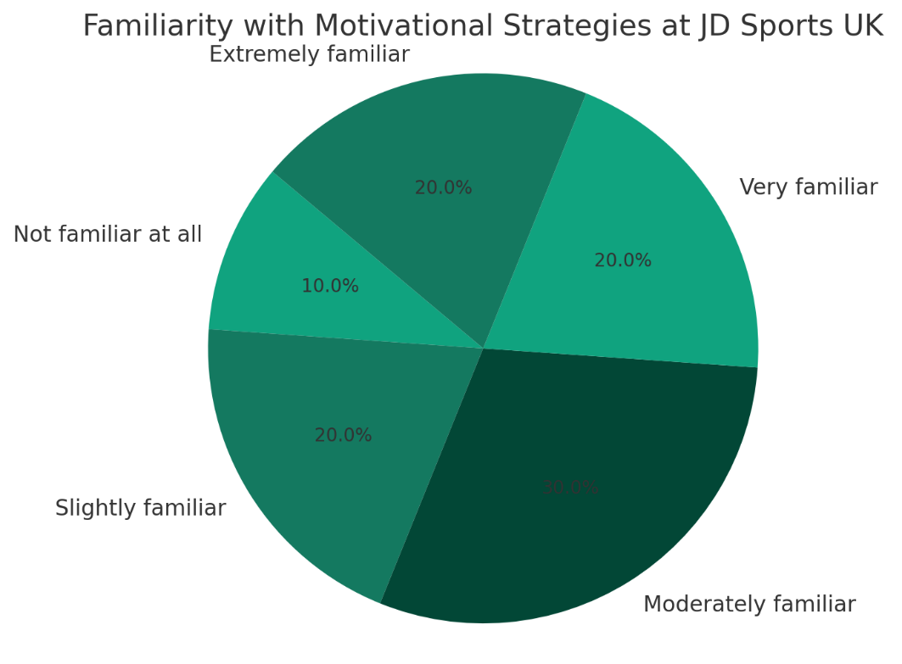
Data Analysis and Results
Findings

Slide 7
Conclusions and Recommendations
Conclusions
Limitation
Recommendations
Areas of Future

Slide 8
Thank you

